Slide 1
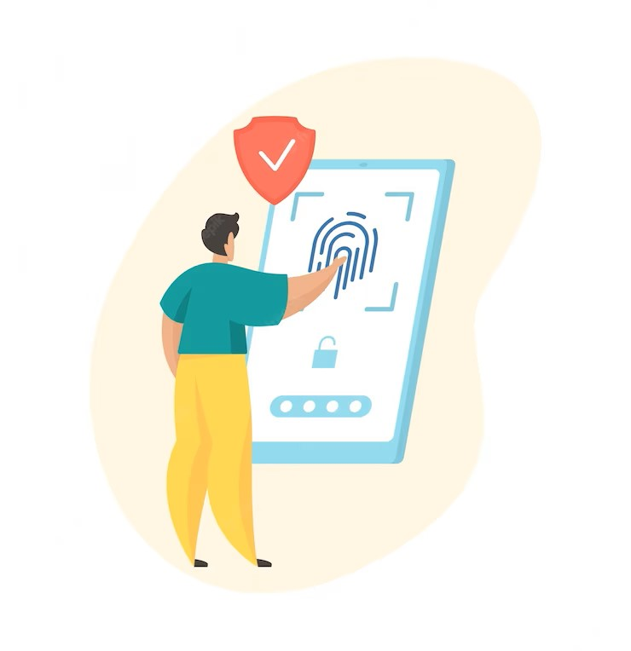

IOT BASED AUTOMATED ATTENDANCE COLLECTION DEVICE AND SYSTEM FOR CLASS ROOM SETTINGS
Revolutionizing Attendance:
Empowering Classroom Efficiency with IoT Automation
Undergraduate Research Project
Supervisor
Eng. R. Valluvan
Co-supervisor
Eng. Proff. K. Ahilan
Eng. Pravina
group Ahamed mza 2019e005
Ahsanullah mrm 2019e006
1

Slide 2
Contents
Timeline
Literature Review
Introduction
Research Gap
Required Components
Progress up to Date
Budget
Future Works

Slide 3

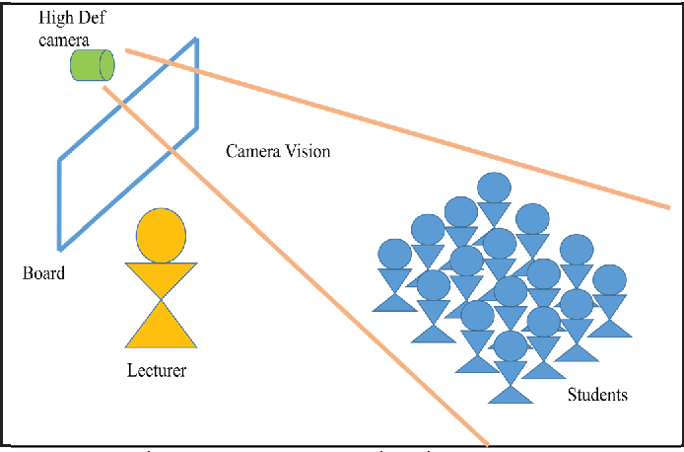
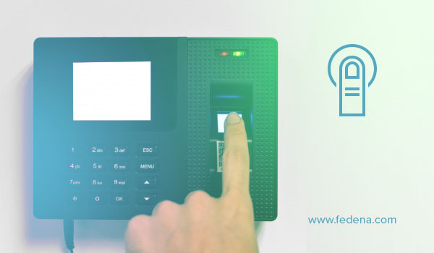
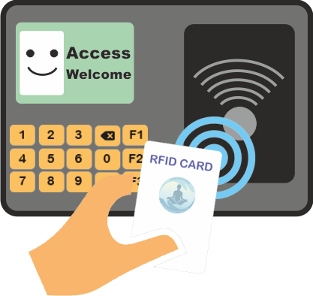
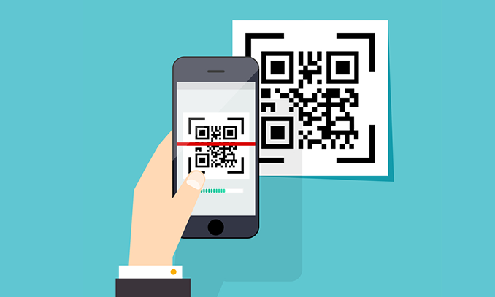
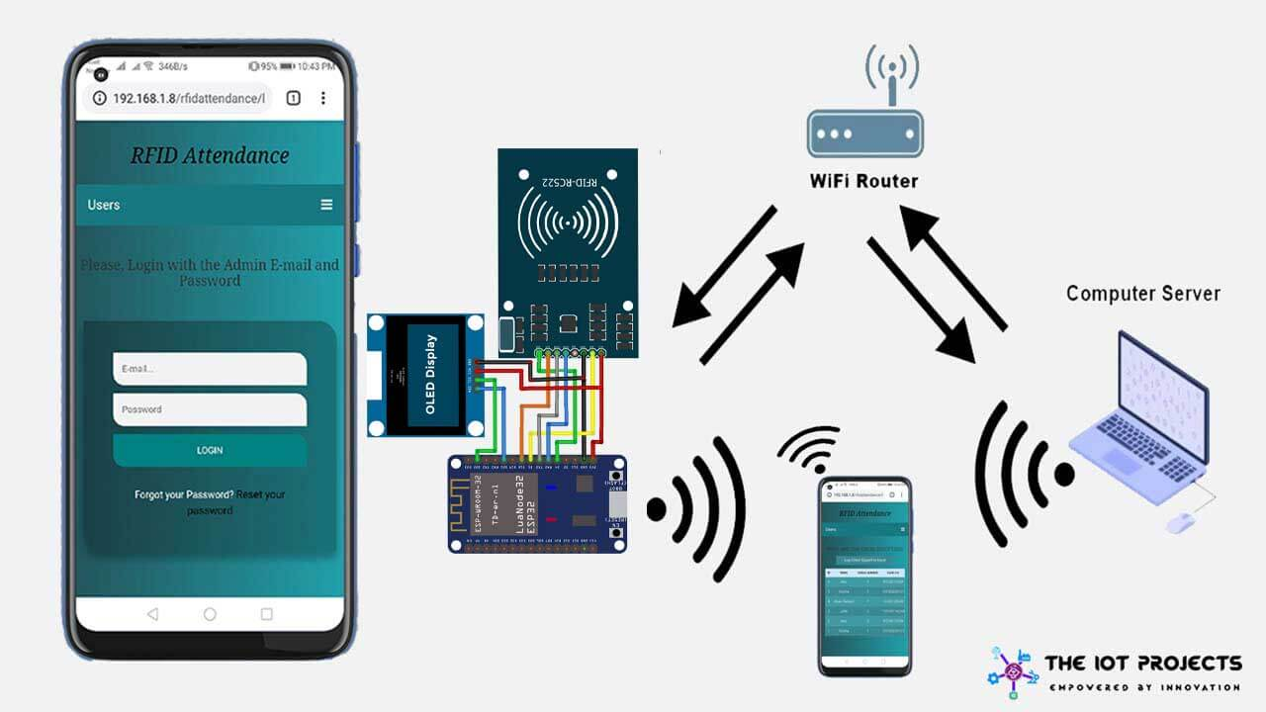
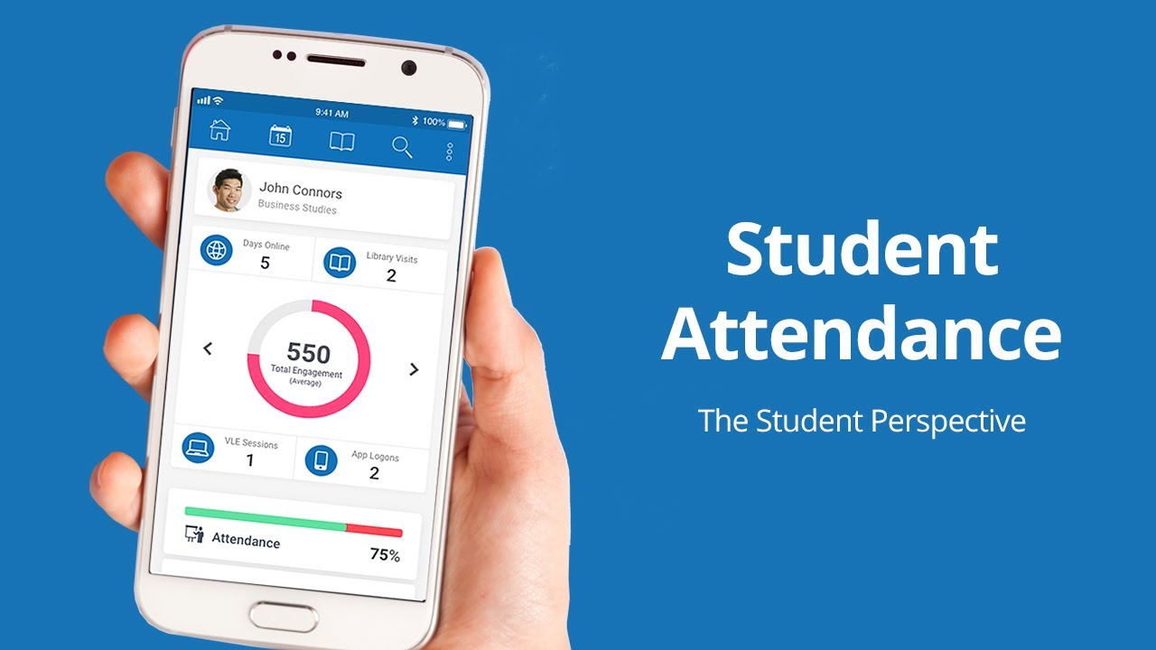
INTRODUCTION
Picture a classroom where attendance becomes a touch away – our cutting-edge IoT solution combines fingerprint recognition and cloud connectivity to redefine the future of effortless and secure attendance tracking
Methods
Biometric
Non-Biometric
IoT technology offers automating attendance
collection & computerizing, Viewing options through cloud & mobile app etc.

Slide 4
Each individual has unique biometric features for identity verification.
Accuracy
Efficiency

Slide 5
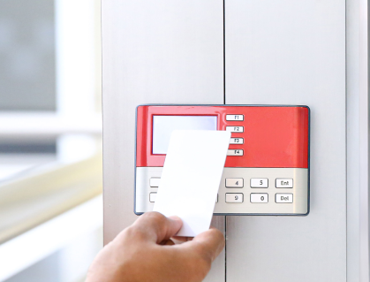
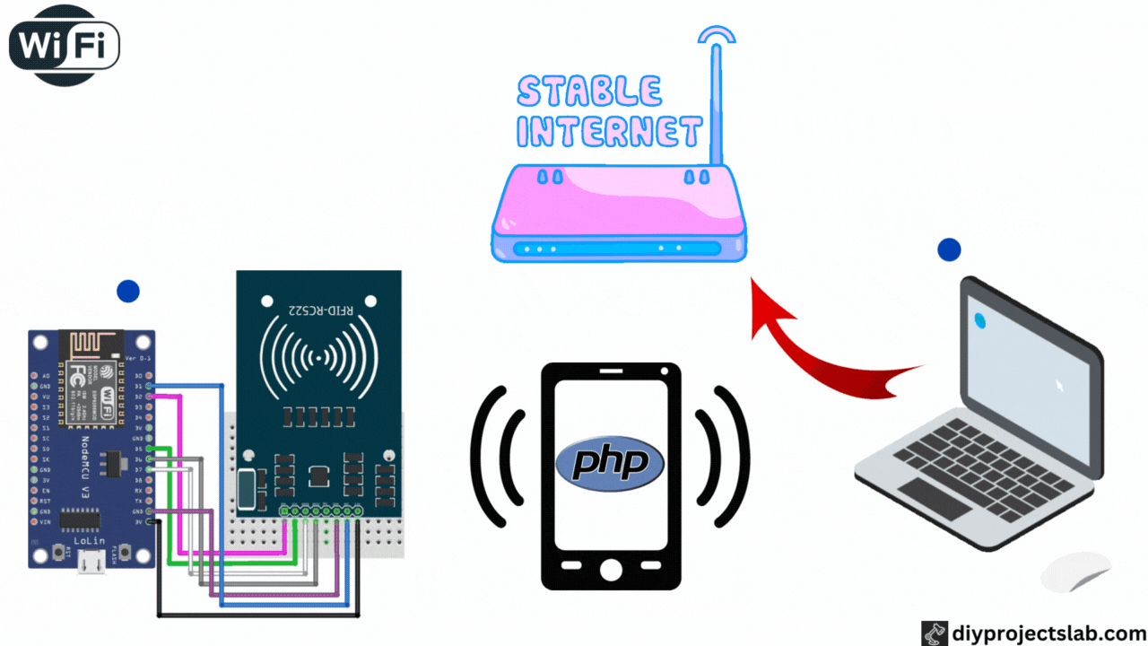
Literature Review
IoT Based Smart Attendance System Using RFID
[1] S. N. Shah and A. Abuzneid, "IoT Based Smart Attendance System (SAS) Using RFID," 2019 IEEE Long Island Systems, Applications and Technology Conference (LISAT), Farmingdale, NY, USA, 2019, pp. 1-6, doi: 10.1109/LISAT.2019.8817339
This Research paper proposed monitoring student attendance using RFID based on IoT. It is a wall mounted device. Their framework gets RFID tags attendance data when students wipe their card & upload to Google Spreadsheet also send alert to parents. It generate a report about attendance with name of the student, date. Admin can view and explore the report. Software’s Front end using the Tkinter Module in Python, The backend is developed using MySQLite3 and open source cloud API. It always connect to power supply & it will change to battery if Power supply removed. Hardware - RFID reader, Atmega328P with Arduino uno.

Slide 6
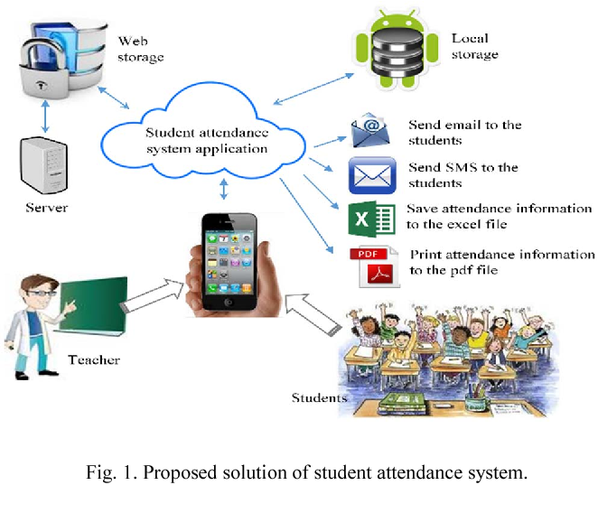
Development of smartphone - based student attendance system
[2] M. M. Islam, M. K. Hasan, M. M. Billah and M. M. Uddin, "Development of smartphone-based student attendance system," 2017 IEEE Region 10 Humanitarian Technology Conference (R10-HTC), Dhaka, Bangladesh, 2017, pp. 230-233, doi: 10.1109/R10-HTC.2017.8288945.
This research proposes mobile application to take attendance The lecturer will provide ID & Password for particular lecture & students who log into it get attendance Attendance data will be save in server and provide percentage of students App will send emails and SMS to the guardian & students to keep them updated about the attendance. They built server in SQLite database Tables for students and teachers with information of their name, ID, address, email & telephone number will be shown in app.

Slide 7
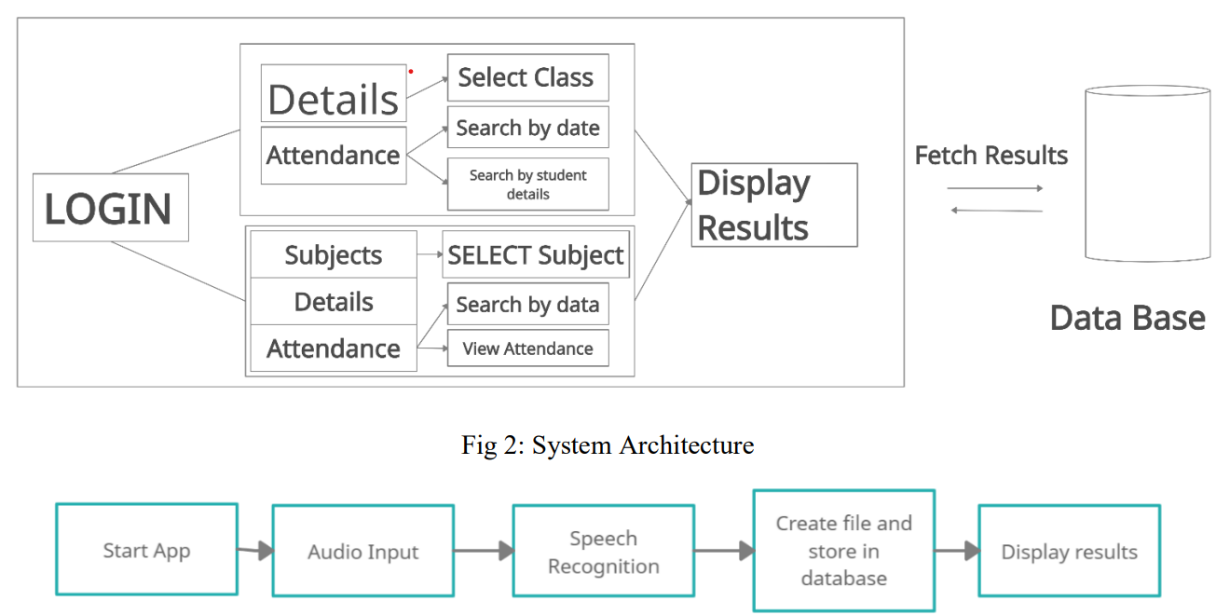

Smart Attendance System Using Speech Recognition
[3] N. Sandhya, R. Vijaya Saraswathi, P. Preethi, K. Aarti Chowdary, M. Rishitha and V. Sai Vaishnavi, "Smart Attendance System Using Speech Recognition," 2022 4th International Conference on Smart Systems and Inventive Technology (ICSSIT), Tirunelveli, India, 2022, pp. 144-149, doi: 10.1109/ICSSIT53264.2022.9716261.
This research proposes a speech recognition attendance system by mobile app User record their Voice using Mobile App microphone, The speech recognizer converts the audio into text by some python code & This text data used to store the appropriate attendance data into the database. Student has to enter secret code, subject which provide by the lecturer. A user interface is also developed to display the attendance with Student personal information, faculty information, subject details and attendance status Admin has full access but lecturer has access to the student details only the classes they teach.

Slide 8
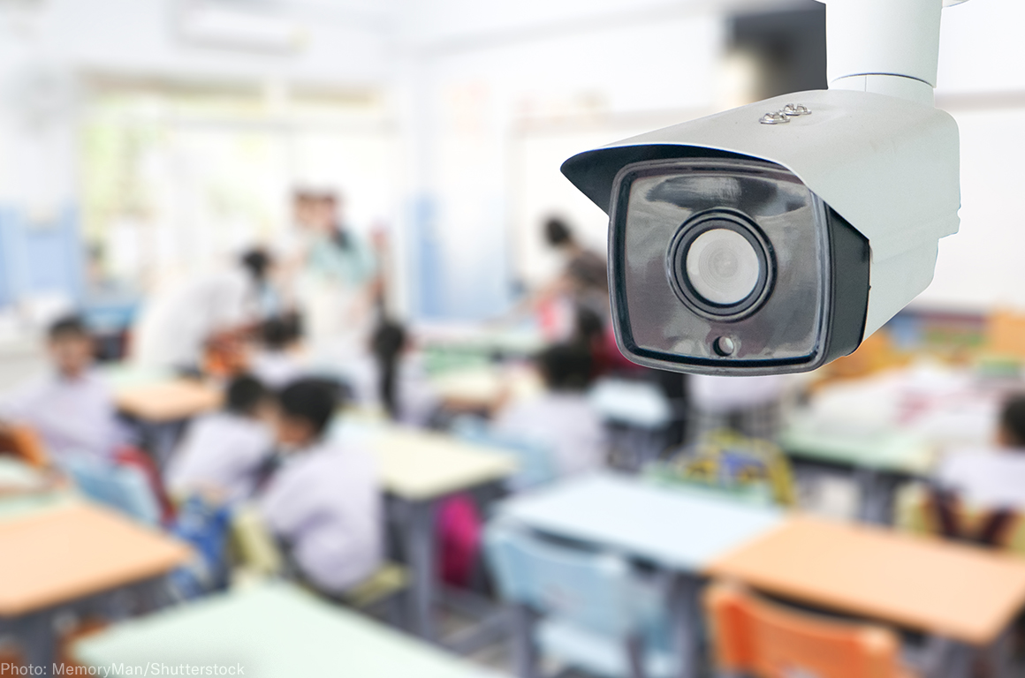
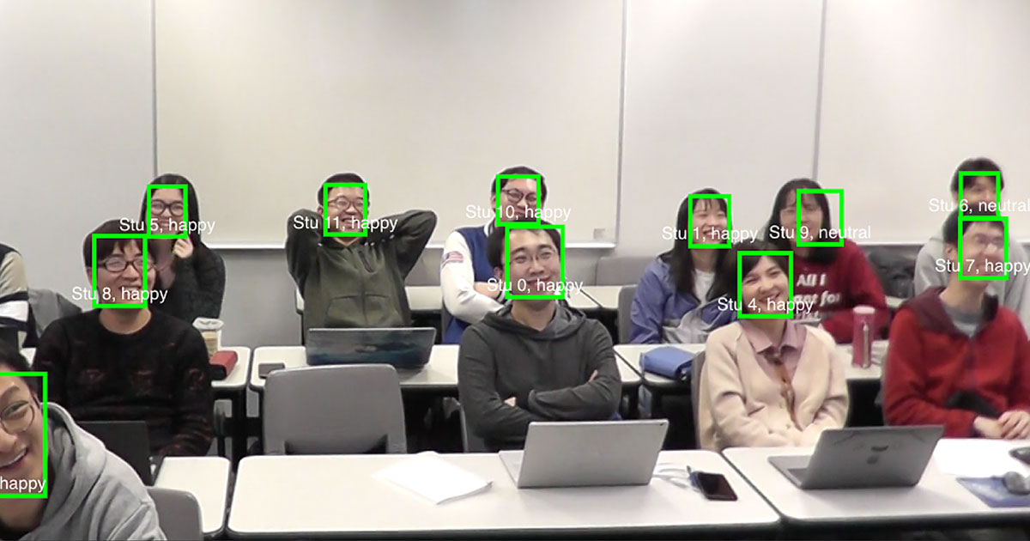
Face Recognition based Attendance Management System
[4] R. Samet and M. Tanriverdi, "Face Recognition-Based Mobile Automatic Classroom Attendance Management System," 2017 International Conference on Cyberworlds (CW), Chester, UK, 2017, pp. 253-256, doi: 10.1109/CW.2017.34.
This research proposes biometrics Face recognition system. This system consists of four phases - database creation, face detection, face recognition, attendance update. The students need to enter the required details in registration form, then the web cam starts detecting about 60 sample face images, images undergo pre-processing & converted from RGB to gray scale images And saved as the names of respective student in a folder then a machine learning model will be created by this training data. In every session, faculty must enter their course code. Then after submitting the course code, the camera which is in class room will detect faces automatically and saved in database Student, Admin can interact with the system using a GUI.

Slide 9
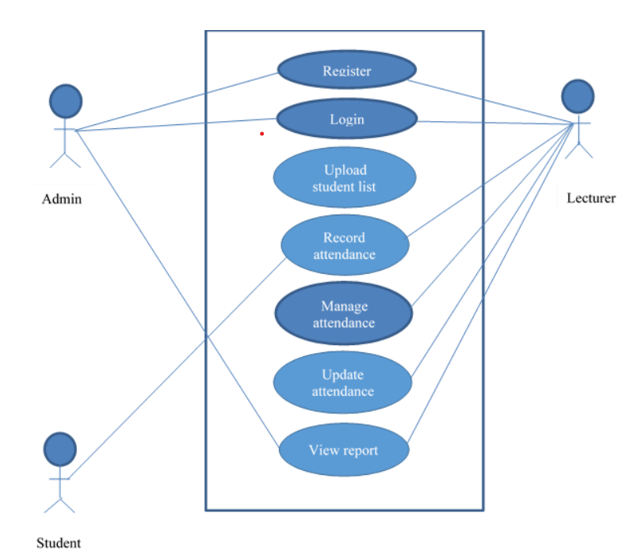
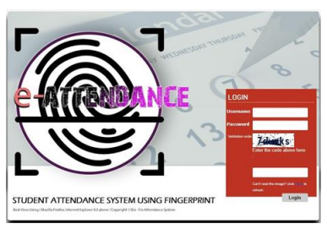
Implementing Student Attendance System Using Fingerprint Biometrics
[5] Lamin, N & Jusoh, W & Zainudin, Juanita & Samad, Hafiza. (2021). Implementing Student Attendance System Using Fingerprint Biometrics for Kolej Universiti Poly-Tech Mara. IOP Conference Series: Materials Science and Engineering. 1062. 012037. 10.1088/1757-899X/1062/1/012037.
This research proposed to get attendance using fingerprint biometrics device installed in the classroom. It is also a wall mounted device. Lecturer alert administration to register the lecturers in the system then Lecturers will receive username and password and they should activate the device with date and time. Admin upload the student list accordingly based on lecturers into the system. updated attendance list will be automatically populated in the system after the end of each class. The username and password are needed in order to log in to the system for student, Admin and lecturers

Slide 10
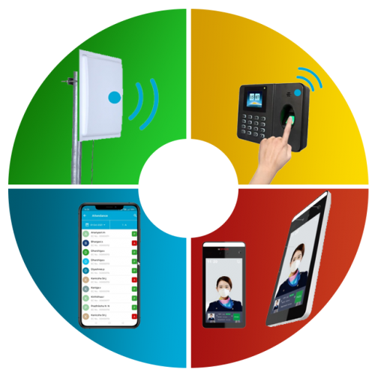

RESEARCH GAP
RFID Based
Students can carry their friends card.
Not Biometric
Not work in offline
Time consuming
Smart Phone App
Absentees can get attendance by getting id & password
Time consuming
Require internet
Not Biometric
Speech Recognition
Noise problem
Not comfortable in lecture room
Not Biometric
Secret code can be shared to absentees

Slide 11
Face recognition system
Image size, image quality, data processing, and angle of camera in the classroom
More amount of camera should be needed
Also students can make fake attendance using the photo of absentee by a phone
Camera quality
Student may wear cap & has Beard
Fingerprint Devices
Wall mounted takes time
fingerprint capacity
Not automatic
Disconnect from Wi-Fi

Slide 12
OBJECTIVE
A portable device equipped with high capacity fingerprint sensors and microcontrollers
The device can be circulated around the classroom
To get Less time consuming
Contain Wi-Fi & SD Card to facilitate data transfer and communicate With database
implement on IoT based system
Where lecturers, instructors, and students can view and manage attendance data
Secure Data management
& Generate Reports

Slide 13
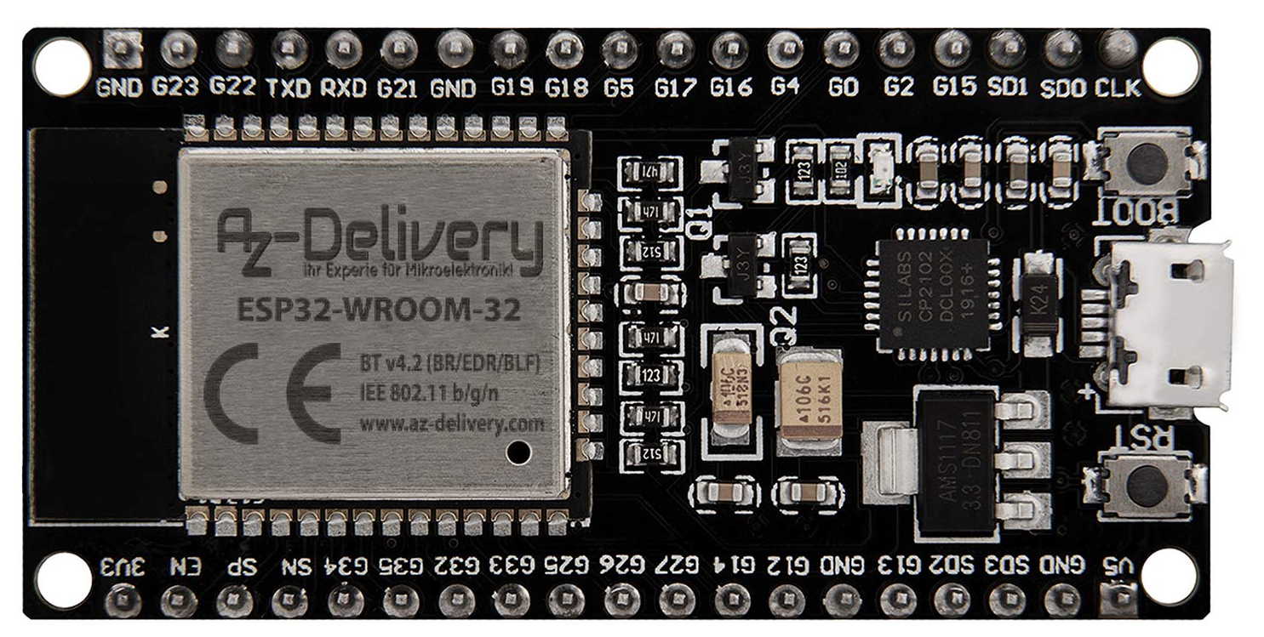
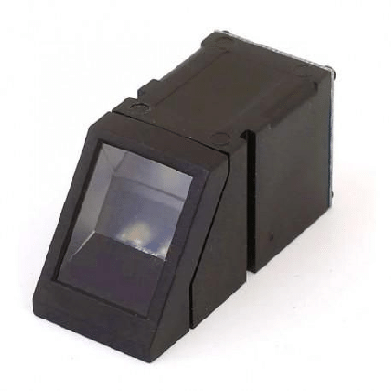
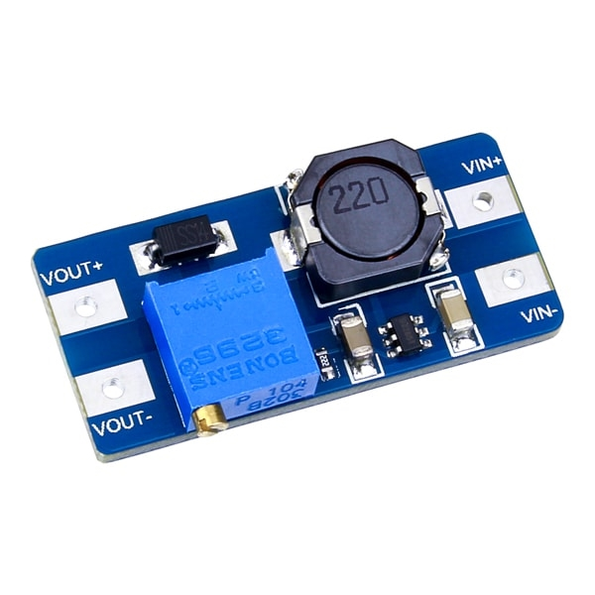
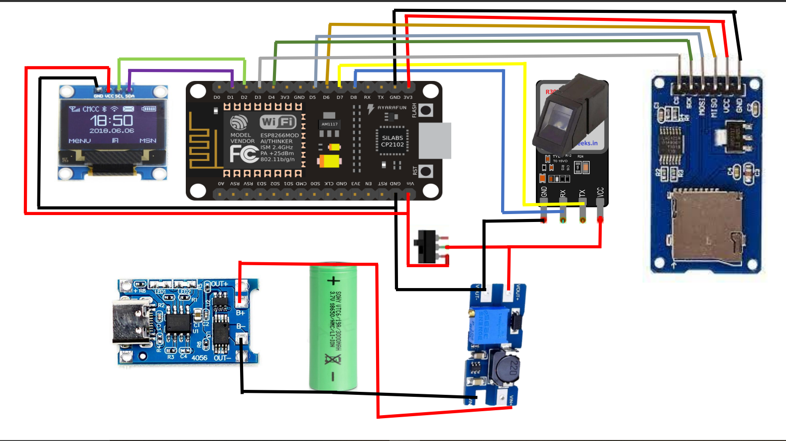
METHODOLOGY
After a detailed review and research we have chosen ESP32 micro controller and other components for best performance and cost effective
Hardware and Software Selection
Connect and integrate all the components with ESP32 micro controller as per our design
Hardware Integration
Software Implementation
Program the components for data processing and communication using Arduino IDE

Slide 14


User Interface and Mobile App Design
Developing the user interface for both the attendance device, Cloud and the mobile application for ease of use and interactivity.
Cloud Connectivity Strategy
Store students data and their fingerprint data using Cloud Services
Security and Privacy Measures
Make Sure Storing data are very safe

Slide 15
Testing and Validation
Test our device’s accuracy and efficiency than traditional method with known data
User Feedback and Iterations
According to user feedback, we improve device's functionality then leading to iterative improvements.
Real-world Deployment Scenario
Presenting a hypothetical scenario of how the IoT-based attendance device would be used in a real classroom setting.

Slide 16
1.COMPONENTS SELECTION
PROGRESS UP TO DATE
NodeMCU Wi-Fi module ESP 8266 / ESP32
Specification | ESP 8266 | ESP32 | ARDUINO UNO | RASPBERRY PI 3
Microcontroller | ESP8266 SOC | ESP32 SOC | ATmega328P | Broadcom BCM2837
CPU | LX106 32-bit, 1 core (80MHz) | CP2102, Dual core >240MHz | 8-bit AVR | Quad-Core ARM Cortex (1.2GHZ)
Operating Voltage | 3.3V - 12 | 3.3V - 12 | 5V - 12 | 5V - 12
Digital I/O Pins | 13 | 36 | 14 | 26
Analog Input pins | 1 | 18(12-bit ADC) | 6(10-bit ADC) | 0
Flash Memory | 4MB | 4MB | 32KB | Micro SD Card slot
WI-FI | Yes | Yes | No | No
Bluetooth | No | Yes | No | Yes (B-4.2)
I/O Voltage | 0 - 3.3V | 0 - 3.3V | 0 – 5V | 0 – 5V
Operating Current | 70-200mA | 70-200mA | Varies | Varies
USB Interface | Micro USB | Micro USB | USB Type-B | Micro USB
RAM | 128KB | 520KB SRAM | 2KB SRAM | 1GB LPDDR2 SDRAM
Cost | 2400/- | 2500/- | 2500/- | 20000/-

Slide 17
Fingerprint module R307/R305/GT-521F52
Specification | R307 | R305 | GT-521F52
Interface | UART | UART | UART
Operating Voltage | DC 5 ~ 6.0V | DC 5 ~ 6.0V | DC 5 ~ 6.0V
Working current | 50mA (typical) | 50mA (typical) | 50mA (typical)
Peak current | 80mA | 80mA | 80mA
Image Resolution | 640 x 480 pixels | 500 dpi | 508 dpi
Image Capture Time | < 0.5 seconds | < 2 seconds | < 0.5 second
Template Storage | Up to 1000 | 160 | Up to 2000
False Rejection Rate (FRR) | < 1% | < 1% | < 0.001%
False Acceptance Rate (FAR) | < 0.001% | < 0.001% | < 0.0001%
Operating Temperature Range | -20°C to +60°C | -20°C to +60°C | -20°C to +70°C
Weight | 20g | 20g | 6g

Slide 18
REQUIRED COMPONENTS
Components | Scope
NodeMCU ESP32 | To connect all other components and process the data as we programmed.
Fingerprint module R307 | To collect fingerprint of students
SD Card module | Store and Collect the data for processing
MT3608 Boost converter (DC to DC) | Regulate the voltage for the required components from microcontroller (5 V to 7.4V)
MT5100 Li-Ion Battery Charging module | To charge the battery
12C Display LED | To show menu and notifications
Li-Ion Battery 18650 4300mAh | To provide power to the device
Switch | To turn on/off the device
4*4 Keypad | To input the ID & control

Slide 19
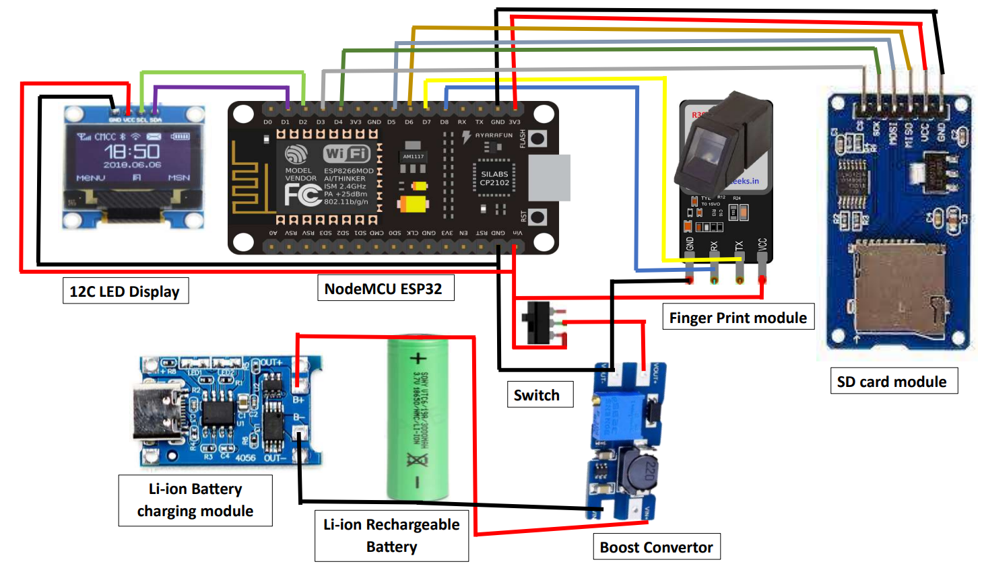
2. CIRCUIT DIAGRAM
We have worked on selecting cost affective and most suitable hardware and build the circuit diagram.

Slide 20
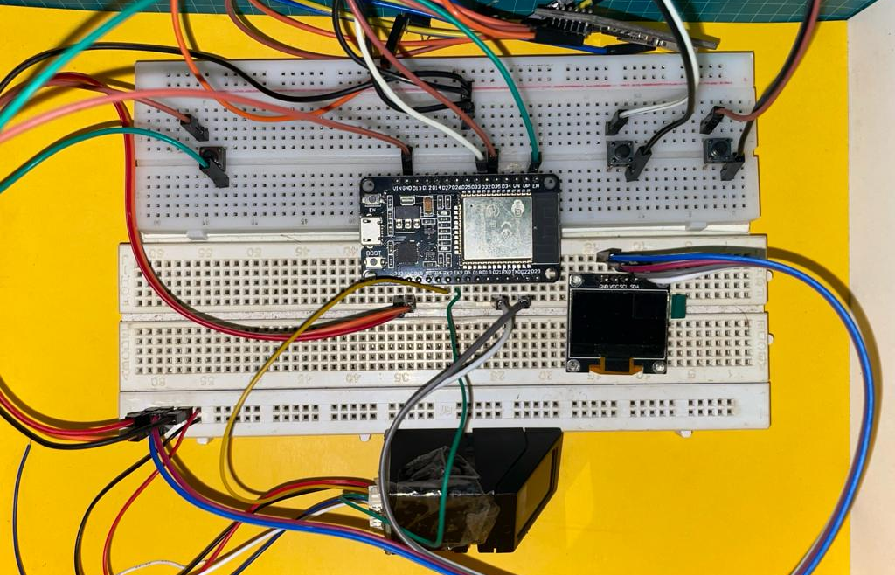
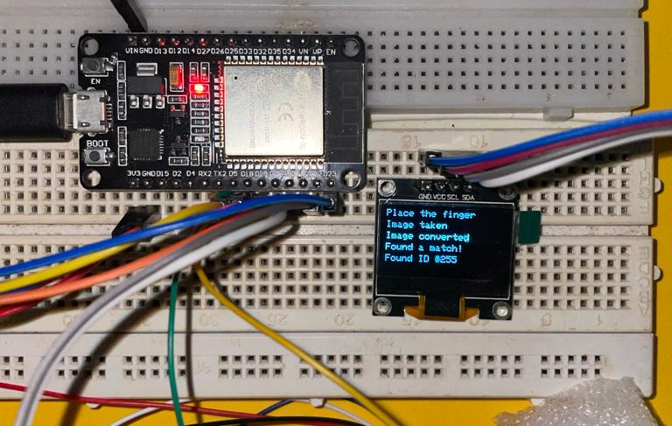
3.Hardware Combination & Configure

Slide 21
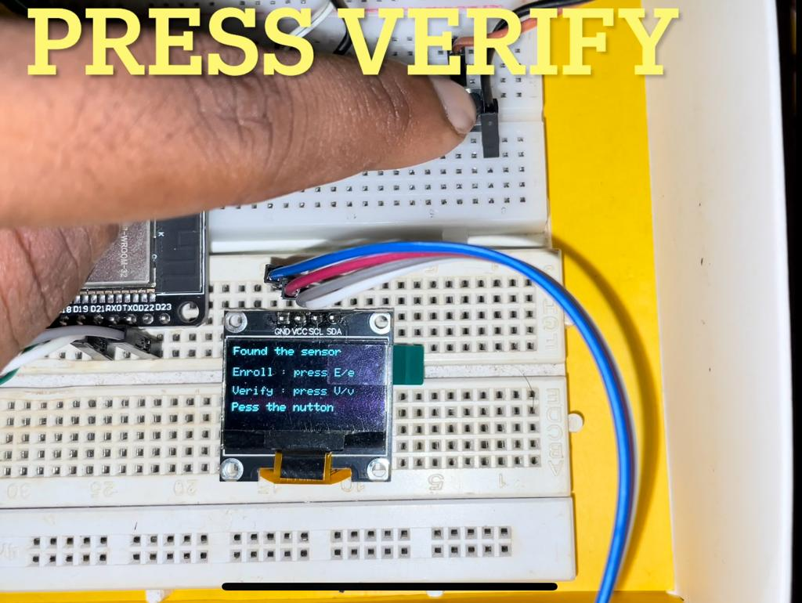
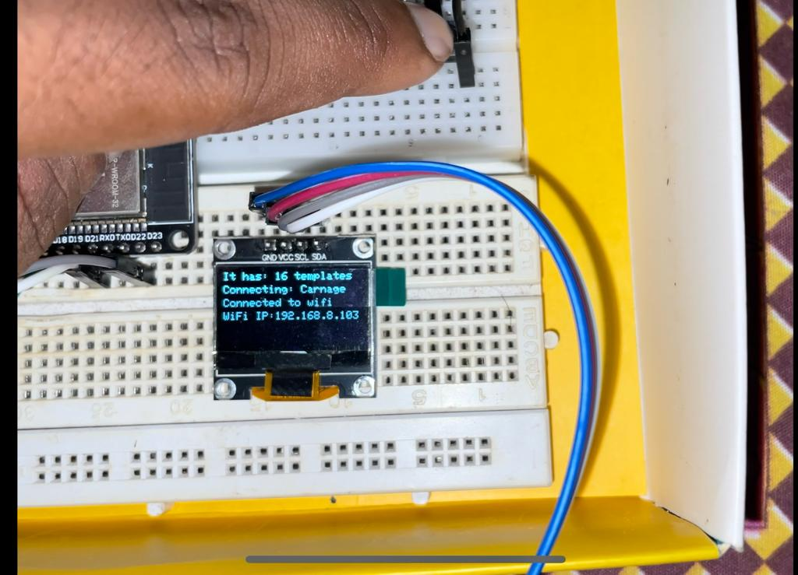
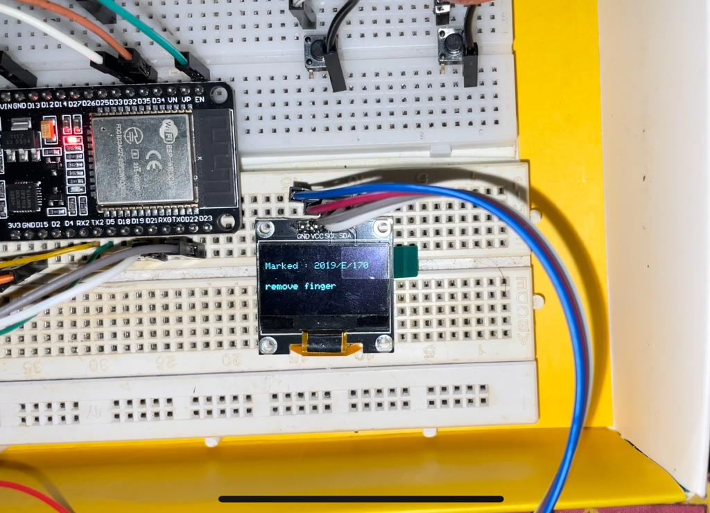
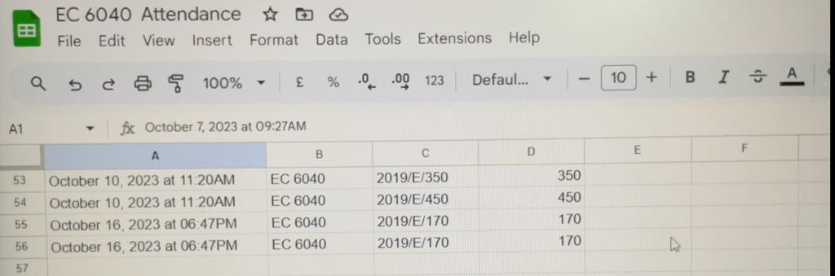
4.Configure To Share The Data To Google Spread Sheet

Slide 22
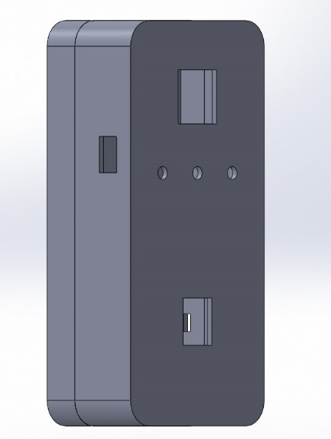
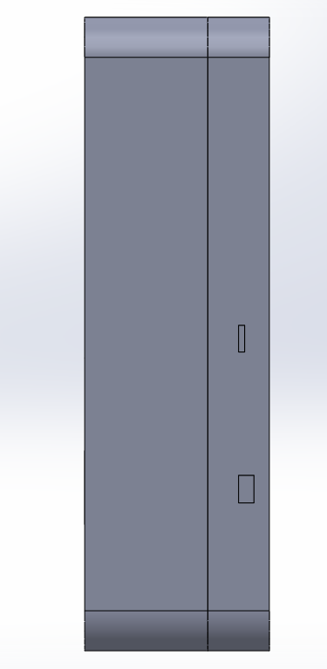
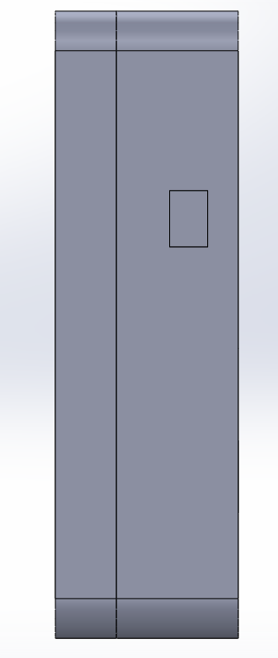
5.SolidWorks Design

Slide 23
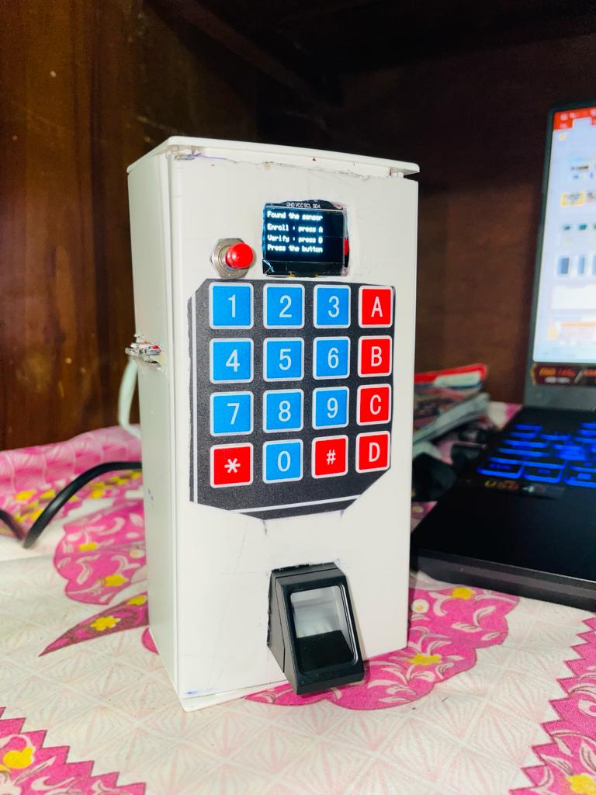
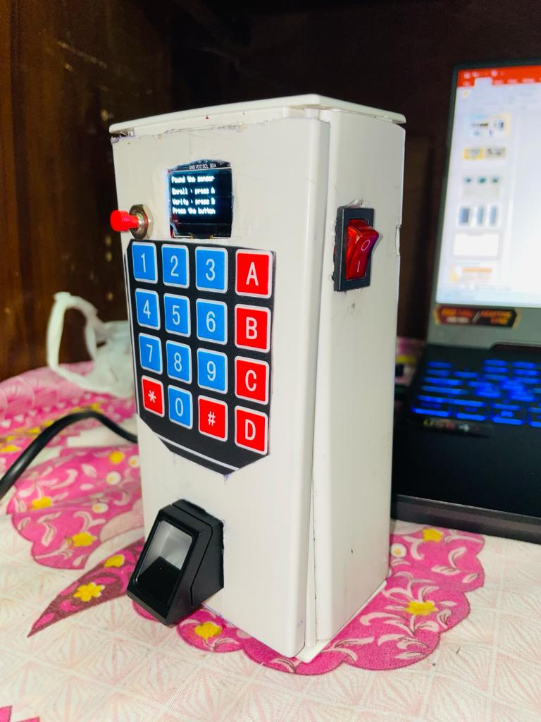
6.Develop Simple Prototype

Slide 24
CHALLENGES AND SOLUTIONS
CHALLENGES | SOLUTIONS
Enrollment was limited for 127 capacity | Configured the library to enroll more number.
Slow detection of Finger print. | Modified code to use hardware Serial communication.
Several Buttons were configured to choose ID input , Select Enroll/Verify | Use a keypad to do all things in one
Code was resetting when we give battery power. | give 7.4V to give enough power.
Configure SD card. | currently working on this problem

Slide 25




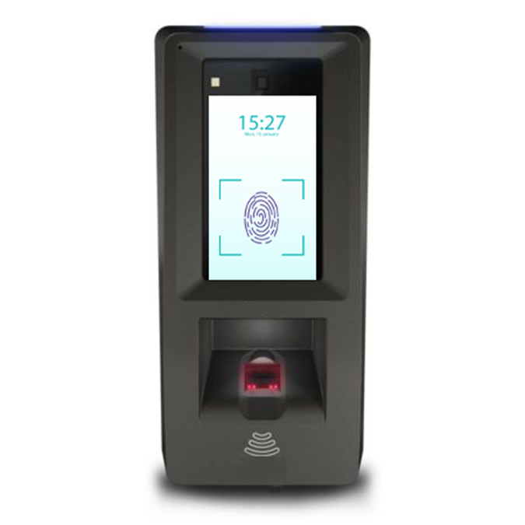
FUTURE WORKS TO DO
Check for Local Host
Develop the cloud and Mobile app using latest software
Combine the Software system & Hardware system.
Overcome the issues Based on the feedback.
Test it & get Feedback.
Build the
final product

Slide 26
Cloud Connection for Our system
Administration Computer
Mobile App
Fingerprint Device

Slide 27
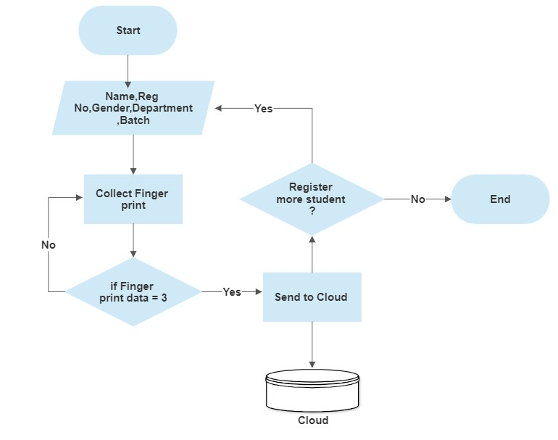
Data Flow for working of the Device

Slide 28
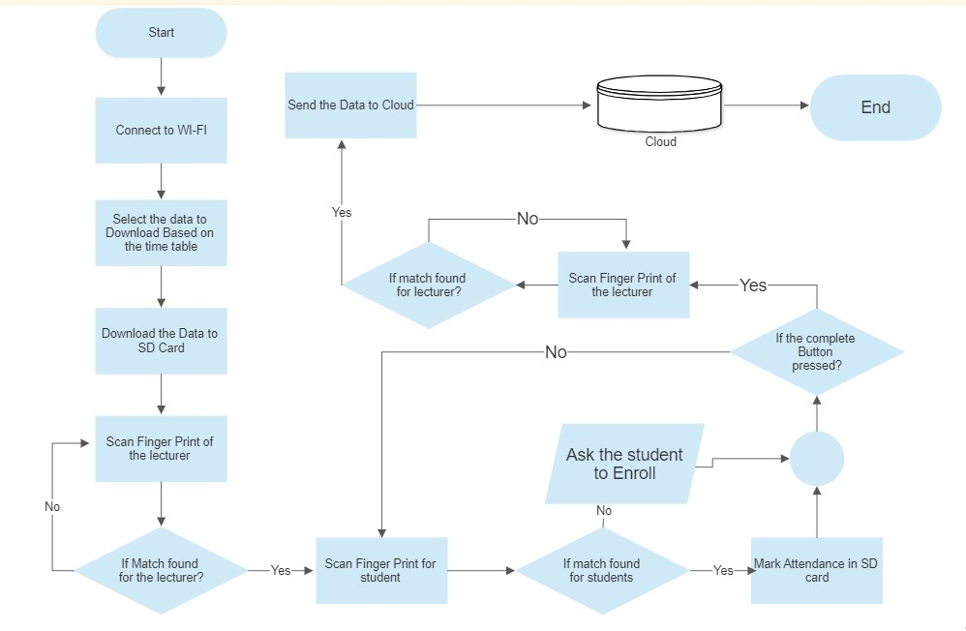
Data Flow for working of the Cloud System

Slide 29
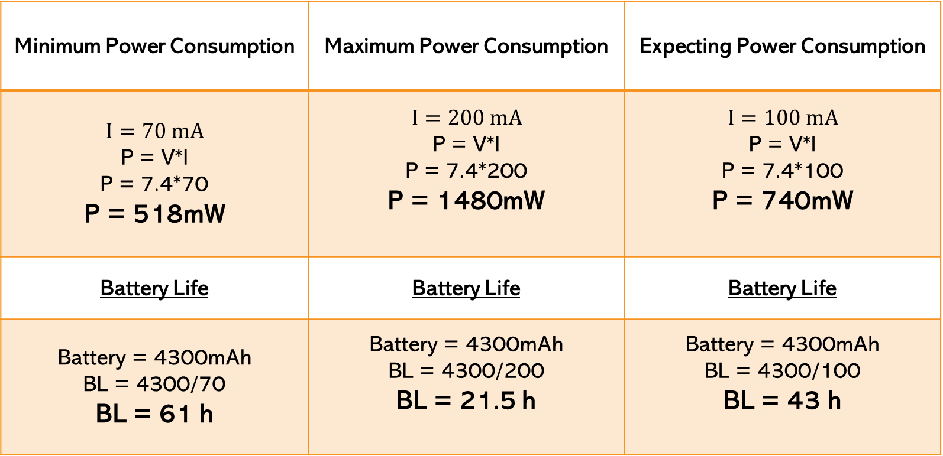
Power Consumption Of The Device
Minimum Power Consumption | Maximum Power Consumption | Expecting Power Consumption
$$I=70 mA$$ P = V*I P = 7.4*70 P = 518mW | $$I=200 mA$$ P = V*I P = 7.4*200 P = 1480mW | $$I=100 mA$$ P = V*I P = 7.4*100 P = 740mW
Battery Life | Battery Life | Battery Life
Battery = 4300mAh BL = 4300/70 BL = 61 h | Battery = 4300mAh BL = 4300/200 BL = 21.5 h | Battery = 4300mAh BL = 4300/100 BL = 43 h

Slide 30
Weight of the Device
Components | Weight (g)
NodeMCU ESP32(WROOM) | 12
Fingerprint module R307 | 20
SD Card module | 6
MT3608 Boost converter (DC to DC) | 4
TP4056 Li-Ion Battery Charging module | 4
12C Display LED | 5
Li-Ion Battery 18650 3000mAh | 45
Switch | 2
CMOS Battery | 3
Total Weight of Components | 100g
Weight of the Housing | 150g
Total Weight of The Device | 250g

Slide 31
BUDGET
Components | Price
NodeMCU ESP32(WROOM) | 3000/-
Fingerprint module R307 | 6000/-
SD Card module | 500/-
MT3608 Boost converter (DC to DC) | 650/-
MT5100 Li-Ion Battery Charging module | 700/-
I2C OLED Module | 1500/-
Li-Ion Battery 18650 4300mAh | 1600/-
Switch Module | 400/-
Total | 14,350/-

Slide 32
Device and Dimension
Dimension = 160 X 80 X 55 mm
Weight = 250g

Slide 33
TIME LINE
 | Phase (Week) | 6th Semester |  |  |  |  |  |  | 7th Semester |  |  |  |  |  |  | 8th Semester
 | Activities | 2 | 4 | 6 | 8 | 10 | 12 | 14 | 2 | 4 | 6 | 8 | 10 | 12 | 14 | 2 | 4 | 6 | 8
01 | Preparation of Project Proposal and Literature review
02 | Design an efficient and reliable develop the hardware required for attendance collection system
03 | Prepare for Research Presentation and Explanation
04 | Design an efficient and reliable develop the software required for attendance collection system
05 | Integrate the system components to connect the sensors to the microcontroller, programming the microcontroller, and connecting the system to google sheet.
06 | Set up cloud-based server to store and local storage
07 | Connecting the system to the cloud server and test.
08 | Integrate your attendance collection system with a cloud-based platform for data storage, analysis, and reporting and test.
09 | Test the whole system to ensure that it is working correctly and improve the issues.
10 | Preparation of Paper and Thesis

Slide 34
References
[1] S. N. Shah and A. Abuzneid, "IoT Based Smart Attendance System (SAS) Using RFID," 2019 IEEE Long Island Systems, Applications and Technology Conference (LISAT), Farmingdale, NY, USA, 2019, pp. 1-6, doi: 10.1109/LISAT.2019.8817339
[2] M. M. Islam, M. K. Hasan, M. M. Billah and M. M. Uddin, "Development of smartphone-based student attendance system," 2017 IEEE Region 10 Humanitarian Technology Conference (R10-HTC), Dhaka, Bangladesh, 2017, pp. 230-233, doi: 10.1109/R10-HTC.2017.8288945.
[3] N. Sandhya, R. Vijaya Saraswathi, P. Preethi, K. Aarti Chowdary, M. Rishitha and V. Sai Vaishnavi, "Smart Attendance System Using Speech Recognition," 2022 4th International Conference on Smart Systems and Inventive Technology (ICSSIT), Tirunelveli, India, 2022, pp. 144-149, doi: 10.1109/ICSSIT53264.2022.9716261.
[4] R. Samet and M. Tanriverdi, "Face Recognition-Based Mobile Automatic Classroom Attendance Management System," 2017 International Conference on Cyberworlds (CW), Chester, UK, 2017, pp. 253-256, doi: 10.1109/CW.2017.34.
[5] Shoewu, Engr. Dr. Oluwagbemiga & Idowu, Ojerinde. (2012). Development of Attendance Management System using Biometrics. https://www.researchgate.net/publication/328416288_Development_of_Attendance_Management_System_using_Biometrics
[6] Lamin, N & Jusoh, W & Zainudin, Juanita & Samad, Hafiza. (2021). Implementing Student Attendance System Using Fingerprint Biometrics for Kolej Universiti Poly-Tech Mara. IOP Conference Series: Materials Science and Engineering. 1062. 012037. 10.1088/1757-899X/1062/1/012037.

Slide 35
Thank you Q&A

